Slide 1

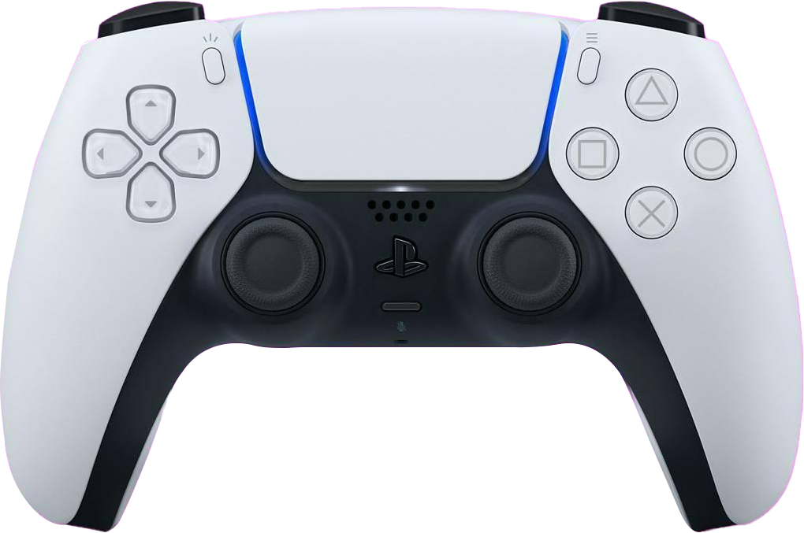
Prediction of Factors effecting
Video Game
Ranking
using data science

Slide 2
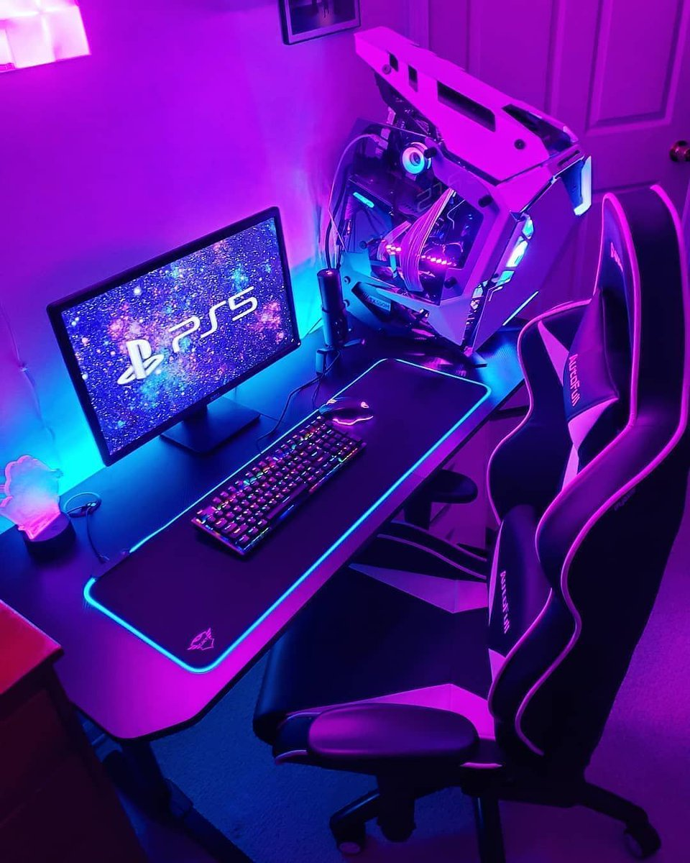
The Problem
According to a report by Newzoo, the global video game market is projected to reach $217.9 billion by 2023. However, only a small percentage of games released each year become successful, with the majority failing to generate significant revenue. This highlights the importance of accurately predicting a game's popularity before investing significant resources in its development and marketing.

Slide 3
The Problem and the targets
The problem we're looking into is predicting the factors effecting video game ranking.
The ranking of a game can have a significant impact on its success, as players frequently use these rankings to decide which games to buy and play.
The target client for this project is the video game industry, specifically game developers, publishers, and marketers.

Slide 4

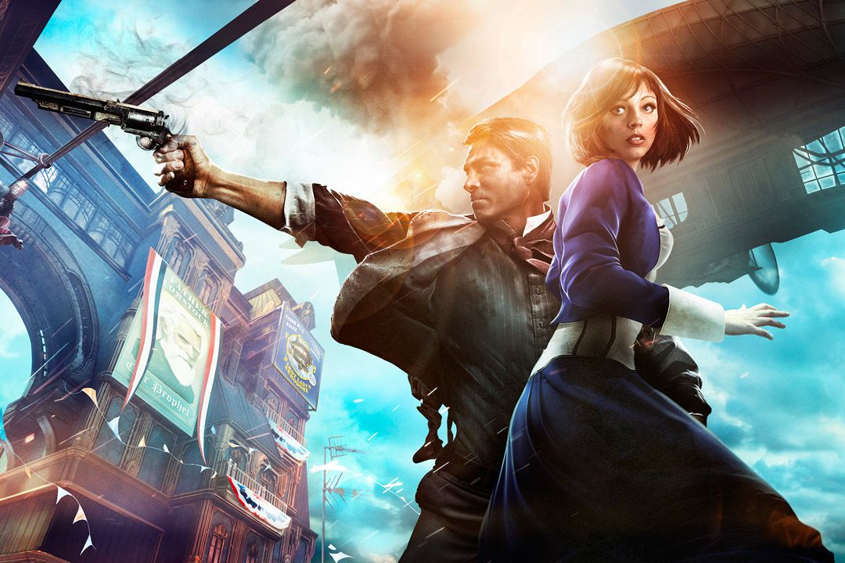
Previous
Work
These following studies used a variety of methods, including machine learning algorithms, neural networks, and hierarchical Bayesian models to predict video game ranking. However, there is still a need for further research and improvement in this area.

Slide 5
Previous Work
Project Title and Author(s) | Methodology Used | Results and Conclusions
Predicting the Popularity of Online Games (H. Kim et al., 2014) | Multiple linear regression, clustering analysis | Found that game genre, gameplay features, and player reviews were significant predictors of game popularity
Predicting Steam's Best Sellers (D. Zhao et al., 2018) | Machine learning algorithms (XGBoost, Random Forest, K-Nearest Neighbor) | Found that user reviews, game price, and release date were the most important features for predicting game success
Predicting the success of video games: A machine learning approach (D. P. Tenório et al., 2019) | Multiple linear regression, decision tree, random forest | Found that game genre, release date, and user reviews were important predictors of game success
Predicting the success of video games with neural networks (A. Chiarini et al., 2019) | Artificial neural networks (ANNs) | Achieved high accuracy in predicting game sales using a combination of game features and sales history

Slide 6
Previous Work
Project Title and Author(s) | Methodology Used | Results and Conclusions
Predicting Steam Game Popularity using Machine Learning Techniques (A. Ahmeti et al., 2019) | Machine learning algorithms (Random Forest, XGBoost, Decision Tree) | Found that user reviews and game length were the most important predictors of game popularity
Predicting Success on the Steam Platform: A Study of Indie Games (J. Hallén and M. Göransson, 2020) | Multiple regression analysis | Found that user reviews, game price, and game length were the most important predictors of success for indie games
Predicting video game success: A hierarchical bayesian approach (M. Ovchinnikov and R. Sundali, 2020) | Hierarchical Bayesian model | Found that game genre and user reviews were important predictors of game success
Game Rank Prediction with Machine Learning Techniques (Y. Zhao et al., 2020) | Machine learning algorithms (Random Forest, XGBoost, K-Nearest Neighbor) | Found that user reviews and game length were the most important predictors of game ranking on Steam

Slide 7

We plan to use data scraping to extract information on video games sales from some Japanese video games sites like Nintendolife and Perfectly Nintendo. We are scraping the data from the sources using python. We are going to clean the obtained dataset and remove duplicates.
Data
Source

Slide 8
Variables
Variable | Description
Game Title | Title of the video game
Release Date | Date the game was released
Genre | Genre of the game
Publisher | Publisher of the game
Price | Price of the game
User Reviews | User reviews and ratings for the game. Positive/Negative
Ranking | Ranking of the game on the platform
Platform | Platform on which the game is being played
Game Length | Length of the total gameplay
Gameplay Features | Key gameplay features such as multiplayer or open-world
Sequel | States if the game is a sequel to another blockbuster game

Slide 9
Durga Mohan Bathula
Mohammed Afeef Shaik
Our Team
Sai Pavan Banala
Kavya Buchikonda

Slide 10


Thank
You

